Slide 1


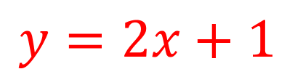
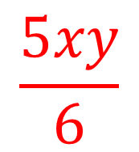
My Algebra
Interactive Notebook
$$\frac{5xy}{6}$$
$$3ab$$
$$2x+3y$$
$$y=2x+1$$
Name
Class
Term 3 Semester 2

Slide 2
Contents
Page
Date
Description
2
3

Slide 3
Tasks
24
7
30
Essential Question
Questions
Notes
Summary
12
13

Slide 4
24
7
30
Date
Solving Equations –Unknown both sides
EQ – How are inverse operations used to solve equations with an unknown on both sides?
13

Slide 5
Mymaths Demo

Slide 6
24
7
30
Date
Solving Equations –Unknown both sides
EQ – How are inverse operations used to solve equations with an unknown on both sides?
If variables are on both sides of an equation, add or subtract it so that the variable appears only on one side.
13

Slide 7
24
7
30
Date
Solving Equations –Unknown both sides
EQ – How are inverse operations used to solve equations with an unknown on both sides?
If variables are on both sides of an equation, add or subtract it so that the variable appears only on one side.
Choose the variable with the smallest coefficient.
13

Slide 8
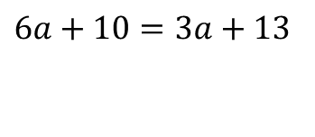
24
7
30
Date
Solving Equations –Unknown both sides
EQ – How are inverse operations used to solve equations with an unknown on both sides?
If variables are on both sides of an equation, add or subtract it so that the variable appears only on one side. Then solve.
Choose the variable with the smallest coefficient.
$$6a+10=3a+13$$
13

Slide 9
24
7
30
Date
Solving Equations –Unknown both sides
EQ – How are inverse operations used to solve equations with an unknown on both sides?
If variables are on both sides of an equation, add or subtract it so that the variable appears only on one side. Then solve.
Choose the variable with the smallest coefficient.
Smallest coefficient
$$6a+10=3a+13$$
13

Slide 10
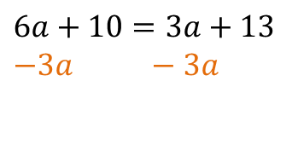
24
7
30
Date
Solving Equations –Unknown both sides
EQ – How are inverse operations used to solve equations with an unknown on both sides?
If variables are on both sides of an equation, add or subtract it so that the variable appears only on one side. Then solve.
Choose the variable with the smallest coefficient.
Smallest coefficient
$$6a+10=3a+13$$
$$−3a −3a$$
13

Slide 11
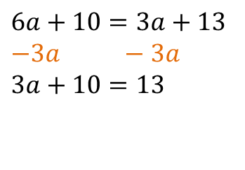
24
7
30
Date
Solving Equations –Unknown both sides
EQ – How are inverse operations used to solve equations with an unknown on both sides?
If variables are on both sides of an equation, add or subtract it so that the variable appears only on one side. Then solve.
Choose the variable with the smallest coefficient.
Smallest coefficient
$$6a+10=3a+13$$
$$−3a −3a$$
$$3a+10=13$$
13

Slide 12
24
7
30
Date
Solving Equations –Unknown both sides
EQ – How are inverse operations used to solve equations with an unknown on both sides?
If variables are on both sides of an equation, add or subtract it so that the variable appears only on one side. Then solve.
Choose the variable with the smallest coefficient.
Smallest coefficient
$$6a+10=3a+13$$
$$−3a −3a$$
$$3a+10=13$$
Two step problem
13

Slide 13
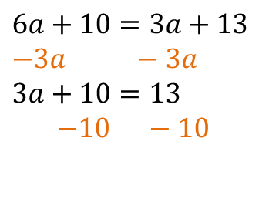
24
7
30
Date
Solving Equations –Unknown both sides
EQ – How are inverse operations used to solve equations with an unknown on both sides?
If variables are on both sides of an equation, add or subtract it so that the variable appears only on one side. Then solve.
Choose the variable with the smallest coefficient.
Smallest coefficient
$$6a+10=3a+13$$
$$−3a −3a$$
$$3a+10=13$$
$$−10 −10$$
Two step problem
13

Slide 14
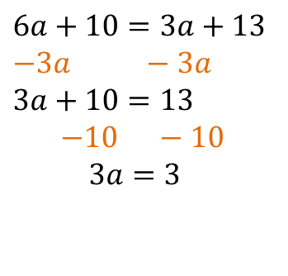
24
7
30
Date
Solving Equations –Unknown both sides
EQ – How are inverse operations used to solve equations with an unknown on both sides?
If variables are on both sides of an equation, add or subtract it so that the variable appears only on one side. Then solve.
Choose the variable with the smallest coefficient.
Smallest coefficient
$$6a+10=3a+13$$
$$−3a −3a$$
$$3a+10=13$$
$$−10 −10$$
$$3a=3$$
Two step problem
13

Slide 15
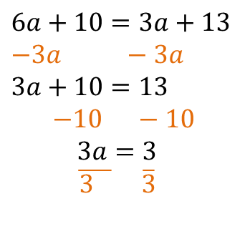
24
7
30
Date
Solving Equations –Unknown both sides
EQ – How are inverse operations used to solve equations with an unknown on both sides?
If variables are on both sides of an equation, add or subtract it so that the variable appears only on one side. Then solve.
Choose the variable with the smallest coefficient.
Smallest coefficient
$$6a+10=3a+13$$
$$−3a −3a$$
$$3a+10=13$$
$$−10 −10$$
$$3a=3$$
$\overline{3 } \overline{3}$
Two step problem
13

Slide 16

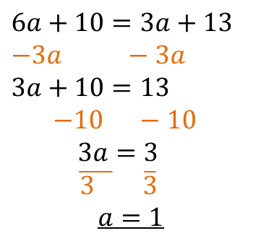
24
7
30
Date
Solving Equations –Unknown both sides
EQ – How are inverse operations used to solve equations with an unknown on both sides?
If variables are on both sides of an equation, add or subtract it so that the variable appears only on one side. Then solve.
Choose the variable with the smallest coefficient.
$$6a+10=3a+13$$
$$−3a −3a$$
$$3a+10=13$$
$$−10 −10$$
$$3a=3$$
$\overline{3 } \overline{3}$
$$a=1$$
$$7b+3=15−5b$$
13

Slide 17
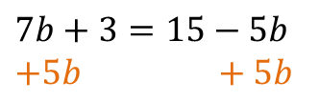
24
7
30
Date
Solving Equations –Unknown both sides
EQ – How are inverse operations used to solve equations with an unknown on both sides?
If variables are on both sides of an equation, add or subtract it so that the variable appears only on one side. Then solve.
Choose the variable with the smallest coefficient.
$$6a+10=3a+13$$
$$−3a −3a$$
$$3a+10=13$$
$$−10 −10$$
$$3a=3$$
$\overline{3 } \overline{3}$
$$a=1$$
$$7b+3=15−5b$$
$$+5b +5b$$
13

Slide 18
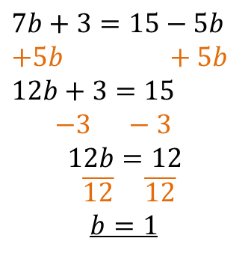
24
7
30
Date
Solving Equations –Unknown both sides
EQ – How are inverse operations used to solve equations with an unknown on both sides?
If variables are on both sides of an equation, add or subtract it so that the variable appears only on one side. Then solve.
Choose the variable with the smallest coefficient.
$$6a+10=3a+13$$
$$−3a −3a$$
$$3a+10=13$$
$$−10 −10$$
$$3a=3$$
$\overline{3 } \overline{3}$
$$a=1$$
$$7b+3=15−5b$$
$$+5b +5b$$
$$12b+3=15$$
$$−3 −3$$
$$12b=12$$
$\overline{12} \overline{12}$
$$b=1$$
13

Slide 19
Fill in the questions

Slide 20
Notes Review
24, 7 ,30
Date
Title
Essential question
Notes complete
Notes complete with colour and diagrams
Questions completed
Contents page filed in
Formula page filled in

Slide 21
Homework
Review your notes and write a summary answering the essential question.

